Slide 1


GOMYCODE
Checkpoint number 23 : Mongo DB
Insert the Sub Title of Your Presentation
Realized by : Asma KHARROUBI
Instructor : Mr. Fedi Touzri
31-01-2023

Slide 2


Default databases
01

Slide 3

Create a database called "contact"
02

Slide 4

Create a collection called "contactlist"
03

Slide 5
Create five collections :
01
02
d
03
d
04
05
04

Slide 6
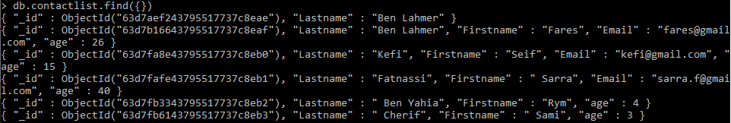
Display all of the contacts list
05

Slide 7
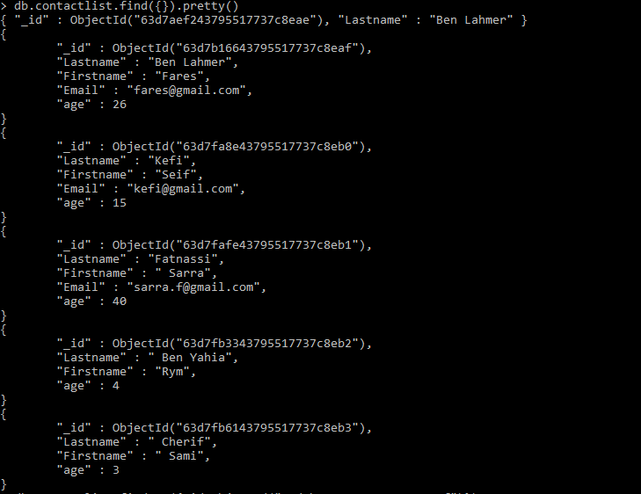
Display all of the contacts list
06

Slide 8
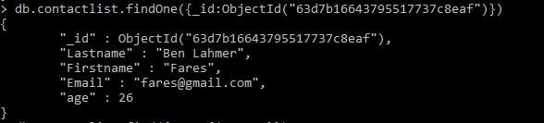
Display all the information about only one person using his ID
ID
07

Slide 9
Display all the contacts with an age >18
08

Slide 10
Display all the contacts with an age>18 and name containing "ah"
09

Slide 11
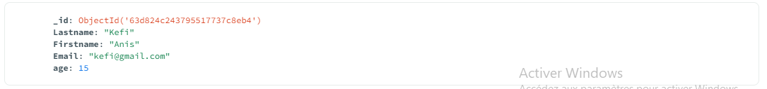
Change the contact's first name from "Kefi Seif" to "Kefi Anis“ :
ere
Collection in Mongo DB Campass :
10

Slide 12
Delete the contacts that are aged under <5
11

Slide 13
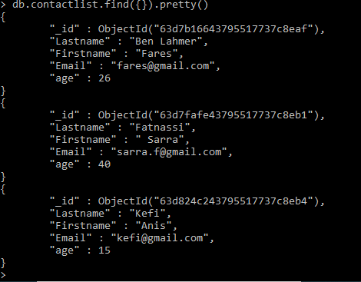
Display all of the contacts list
12

Slide 14
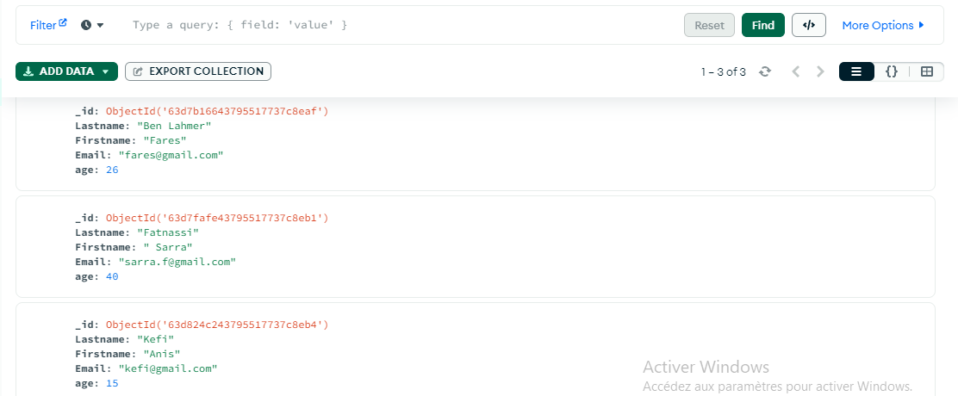
Contact database in Mongo DB Campass :
13

